Slide 1

Software requirements (swr302)
Change Happen (chapter 28)

Slide 2
Why manage changes?
Proposed requirements changes are thoughtfully evaluated before being committed to.
Appropriate individuals make informed business decisions about requested changes.
Change activity is made visible to affected stakeholders.
Approved changes are communicated to all affected participants.
The project incorporates requirements changes in a consistent and effective fashion.

Slide 3
Change control policy
All changes must follow the process. If a change request is not submitted in accordance with this process, it will not be considered.
No design or implementation work other than feasibility exploration will be performed on unapproved changes.
Simply requesting a change does not guarantee that it will be made. The project’s change control board (CCB) will decide which changes to implement.
The contents of the change database must be visible to all project stakeholders.
Impact analysis must be performed for every change.
Every incorporated change must be traceable to an approved change request.
The rationale behind every approval or rejection of a change request must be recorded.

Slide 4
A change control process description
Entry criteria, the conditions that must be satisfied before the process execution can begin
The various tasks involved in the process, the project role responsible for each task, and other participants in the task
Steps to verify that the tasks were completed correctly
Exit criteria, the conditions that indicate when the process is successfully completed

Slide 5
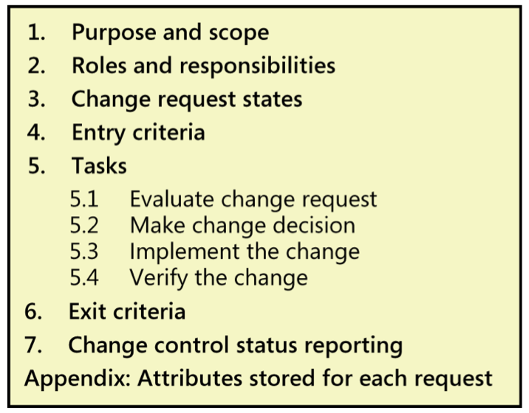
A change control process description
Entry criteria, the conditions that must be satisfied before the process execution can begin
The various tasks involved in the process, the project role responsible for each task, and other participants in the task
Steps to verify that the tasks were completed correctly
Exit criteria, the conditions that indicate when the process is successfully completed

Slide 6
The change control board
CCB composition
Project or program management
Business analysis or product management
Development
Testing or quality assurance
Marketing, the business for which the application is being built, or customer representatives
Technical support or help desk
CCB charter
Making decisions
Communicating status
Renegotiating commitments

Slide 7
Change control tools
To support your change process, look for a tool that:
Allows you to define the attributes that constitute a change request.
Allows you to implement a change request life cycle with multiple change request statuses.
Enforces the state-transition model so that only authorized users can make specific status changes.
Records the date of each status change and the identity of the person who made it.
Provides customizable, automatic email notification when an Originator submits a new request or when a request’s status is updated.
Produces both standard and custom reports and charts.

Slide 8
Measuring change activity
Tracking the following aspects of your requirements change activity:
The total number of change requests received, currently open, and closed
The cumulative number of added, deleted, and modified requirements
The number of requests that originated from each change origin
The number of changes received against each requirement since it was baselined
The total effort devoted to processing and implementing change requests

Slide 9
Change impact analysis Impact analysis procedure
Understand the possible implications of making the change. A requirement change often produces a large ripple effect, leading to modifications in other requirements, architectures, designs, code, and tests. Changes can lead to conflicts with other requirements or can compromise quality attributes, such as performance or security.
Identify all the requirements, files, models, and documents that might have to be modified if the team incorporates the requested change.
Identify the tasks required to implement the change, and estimate the effort needed to complete those tasks.
Notes:
Ripple: gợn sóng

Slide 10
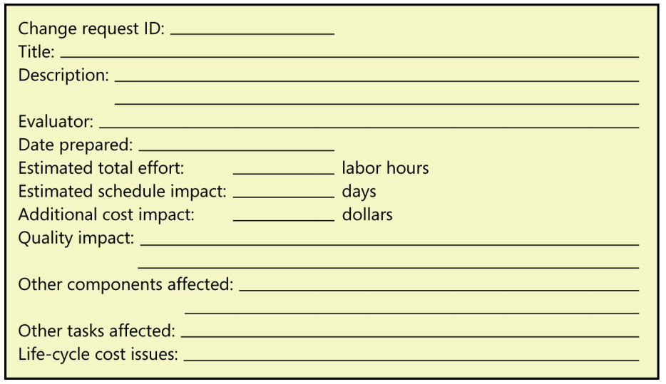
Change impact analysis Impact analysis template

Slide 11
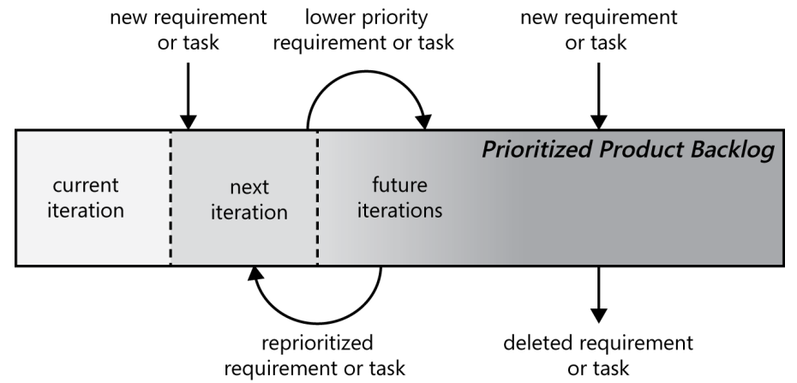
Change management on agile projects
One of the 12 principles of agile software development is “Welcome changing requirements, even late in development. Agile processes harness change for the customer’s competitive advantage”

